Slide 1
Serverless & Event-Driven Architectures: Building with AWS Lambda
💖
AWS LAMBDA

Slide 2

E. N. Mingle @native_niiakwei
AWS Authorized Instructor | AWS Community Builder | Cloud Consultant

Slide 3
Agenda
01
Intro to Serverless Architecture
02
AWS Shared Responsibility Model
03
Microservices x Serverless
04
Advantages of Serverless
05
Case Study: DoorDash
06
Demo: Lambda + SNS + EventBridge
Confidential

Slide 4
-less [lɛs]
suffix
Definitions
The suffix -less means without. It is used to form adjectives that indicate the absence of something.
eg. borderless - without border
paperless - without paper
Confidential

Slide 5
serverless [səːvəlɛs]
adjective
Definition
without servers

Slide 6

not quite
Is serverless infrastructure truly without servers

Slide 7
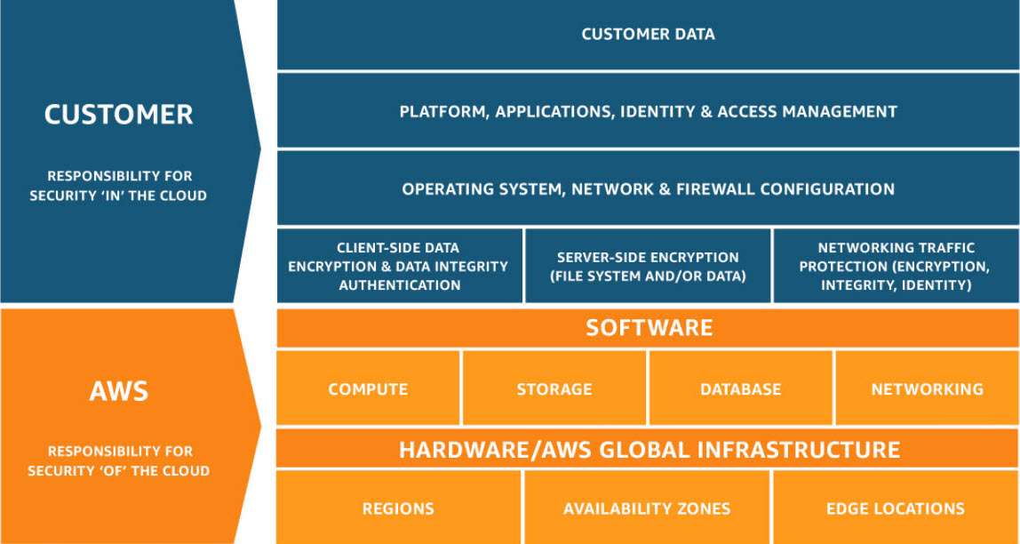
AWS Shared Responsibility Model

Slide 8
What is Serverless Computing
Serverless computing is an application development model where you can build and deploy applications on third-party managed server infrastructure. All applications require servers to run

Slide 9
Key Principles of Serverless Computing
Principle 1 - Function as a Service(FaaS)
Where developers run code in response to events without managing underlying infrastructure.
Principle 2 - Backend as a Service(BaaS)
Provision of Backend services such as database, authentication, and storage through APIs
Principle 3 - Event Driven Architecture
Event-driven means responding to event triggers such as HTTP requests or changes in some services

Slide 10
What is Serverless Computing
Serverless computing is an application development model where you can build and deploy applications on third-party managed server infrastructure. All applications require servers to run

Slide 11
Advantages of Serverless Architecture
Cost Efficiency
Scalability
Improved Developer Productivity
Security
Pay-per-use model where you get to pay for only what you use to run a task.
Services scale up or down based on demand without you necessarily having to intervene
Developers do not have to worry about infrastructure for example. Key focus on productivity.
Security is built in for services.

Slide 12
Microservices architecture involves dividing an application into a set of loosely coupled, independently deployable services.
Microservice Architecture

Slide 13
Serverless x Microservices
Microservices and serverless computing are two architectural paradigms that have gained significant popularity in modern software development. Both offer distinct advantages and can be used to build scalable, resilient, and cost-effective applications.

Slide 14














Examples of AWS Serverless Services
Compute
Data store
AWS Lambda
Amazon S3
AWS Fargate
Amazon EFS
Amazon DynamoDB
Amazon EventBridge
Amazon Aurora Serverless & DSQL
Amazon Step Functions
Amazon SQS
Amazon DocumentDB Serverless
Amazon SNS
Amazon OpenSearch Serverless
Amazon API Gateway
Amazon ElastiCache Serverless
Application Integration

Slide 15

Use Case: DoorDash Processed More Than 10 Million Sweepstakes Entries on AWS

Slide 16
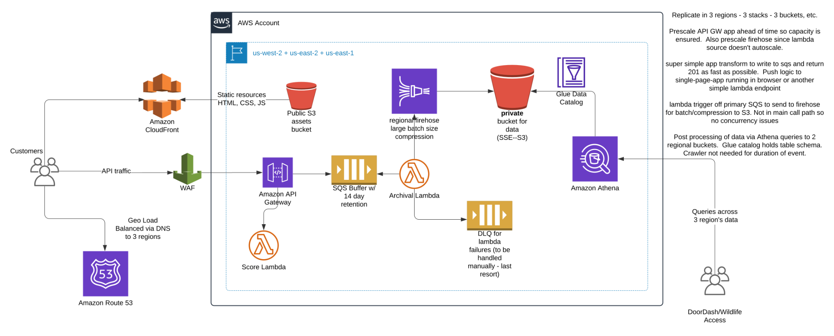

Slide 17
Services Used by DoorDash
AWS Lambda
Amazon API Gateway
Amazon Route 53
Amazon SQS

Slide 18
Thank you!

